Slide 1
Cookbook for Practice 3.1
实践3.1攻略
Cong Li 李聪

Slide 2

numpy array numpy数组 (1)
Duplicate ‘simply_njit.py’ as ‘array_njit.py’
将’simply_njit.py’复制为’array_njit.py’
Import the ‘numpy’ library
导入’numpy’库
While numpy is very powerful, here we only use its array data structure: a ‘contiguous’ space to store values
尽管numpy非常强大，这里我们只用到其中的数组结构：一段“连续”的空间用来存储数值

Slide 3
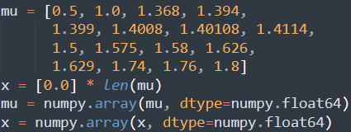
numpy array numpy数组 (2)
After initializing ‘x’ & ‘mu’, convert them to
numpy arrays of 64-bit floating point numbers
当初始化’x’和’mu’之后，将它们转为64位浮点数类型的numpy数组

Slide 4

numpy array numpy数组 (3)
Change initialization of the record storage from
将保存记录的初始化由
to the use of numpy array
改为使用numpy数组

Slide 5
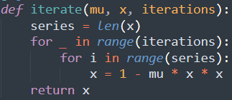
Operate on Arrays
在数组上操作 (1)
Now in the ‘iterate’ function, we operate ‘x’ & ‘mu’ in arrays
现在在’iterate’函数中，我们把’x’和’mu’当作数组操作
Check the array size, & then add an additional loop for it
检查数组大小，并为之增加一个额外的循环

Slide 6

Operate on Arrays
在数组上操作 (2)
In the inner loop body, operate each array element
在内重循环体中，操作每个数组元素
Finally, add the ‘fastmath’ option to the ‘njit’ function decorator to enable aggressive optimization in compilation
最后，在函数标饰处加上’fastmath’选项，
以在编译启用更为激进的优化

Slide 7
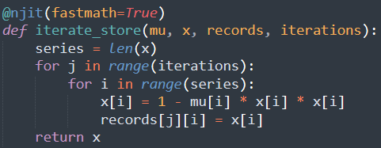
Operate on Arrays
在数组上操作 (3)
Similarly, write another function to calculate & record
类似的，再写一个函数既做计算又做记录

Slide 8


Warm up 预热
Delete the original warm-up process
删除原先的预热过程
After initializing ‘records’, warm both the 2 functions up to
trigger JIT compilation w/ small iteration number & data copies
在初始化’records’结束后，用小的迭代轮数和数据
副本预热这两个函数，以触发即时编译

Slide 9
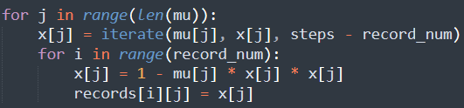

Calculation & Recording
计算与记录
Change the original calculating & recording from
将原先的计算和记录
to simple function calls
改为简单的函数调用
Run it 运行之
python array_njit.py

Slide 10
The End

